Slide 1

Separation Connector Improvement for Orbital Sciences Corporation
College of Engineering, Forestry, and Natural Sciences
Department of Mechanical Engineering
Northern Arizona University
Koll Christianson, Luis Herrera

Slide 2
Presentation Overview
Project Overview
Problem Statement
Design Requirements
Design Proposal
First Prototype
Deflection Analysis
Final Design
Results
Conclusion

Slide 3
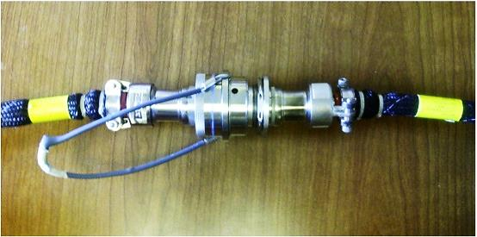
Project Overview
Original Separation Connector
Part # MIL-DTL-38999L
Notes:
DESCIRibe the connector and what it does

Slide 4
Problem Statement
The goal of this project is to design and demonstrate our concept that meets cost goals (DTC), enhances design for manufacturing and assembly (DFM/DFA), and meets or exceeds current reliability.

Slide 5
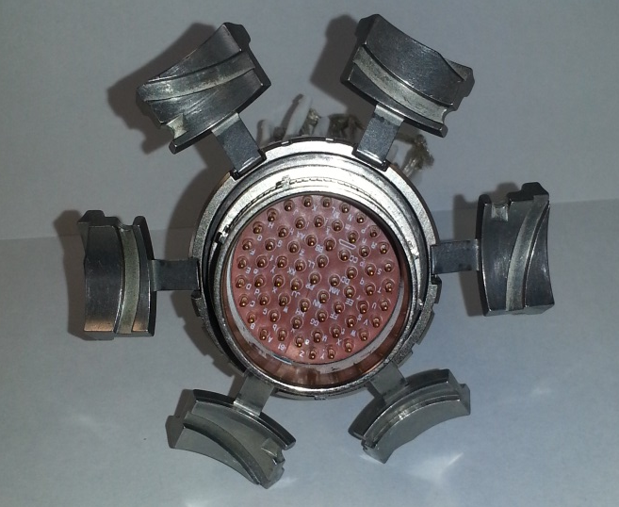
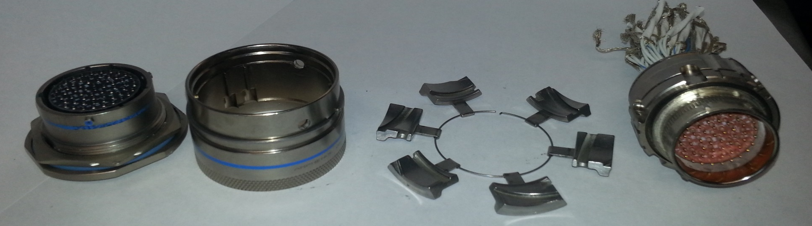
Current Design
Reduce number of parts to increase reliability, enhance design for manufacturing and assembly, and reduce cost.
1
2
10
4
6
3
5
7
8
9

Slide 6
Design Requirements
Male end cannot be changed
Pass military environmental requirements
Separates with10-30 lbf. in tension
Structural integrity to withstand 200 lbf.
Easy to manufacture
Mate and de-mate at least 50 times without failure (cycle reliability)
Cannot exceed an increase in size of 25% greater than the original design

Slide 7
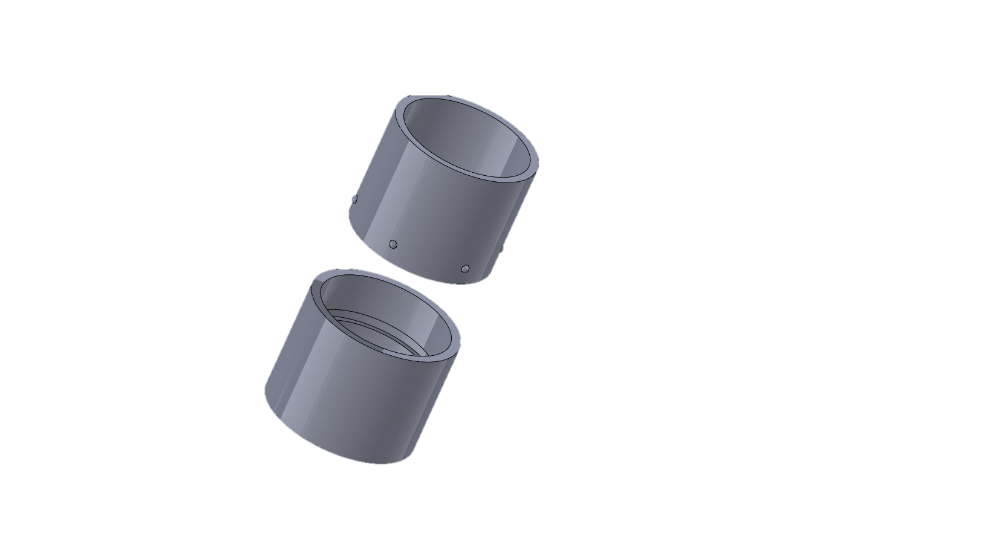
Design Proposal
Preliminary Design
Male End
Ball Detent
Female End
Retention Track

Slide 8
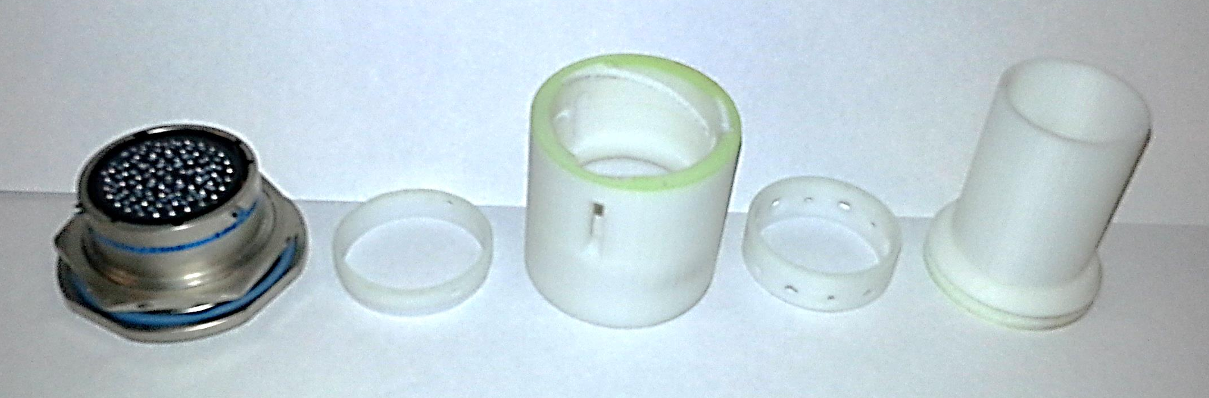
FDM Prototype (Components)
Female End
Male End
Coupling
Ball Bearing Retention Ring
Pressure Plate

Slide 9
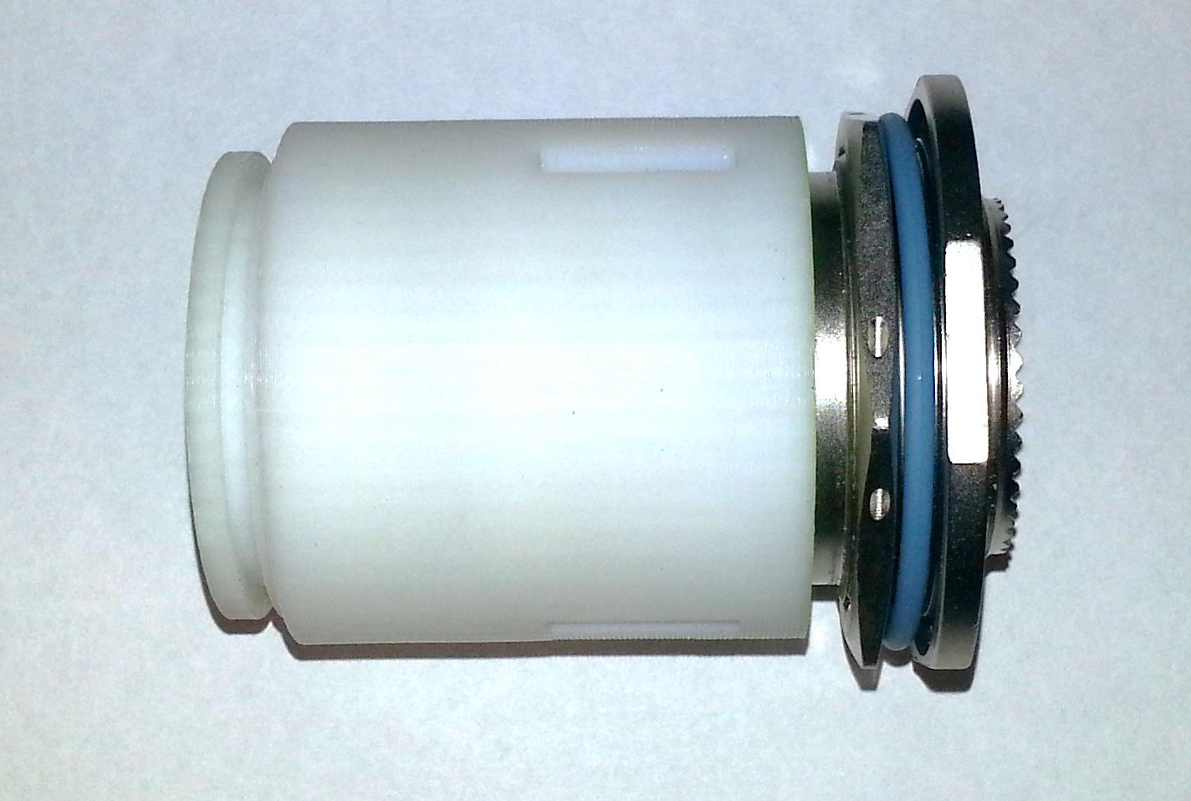
FDM Prototype (Assembled)

Slide 10
Modifications to FDM Design
Combined:
Female End
Ball Bearing Retention Ring
Added:
Spring Retention Ring
Changed:
Coupling
Removed:
Pressure plate
Ball Bearing Retention Ring

Slide 11
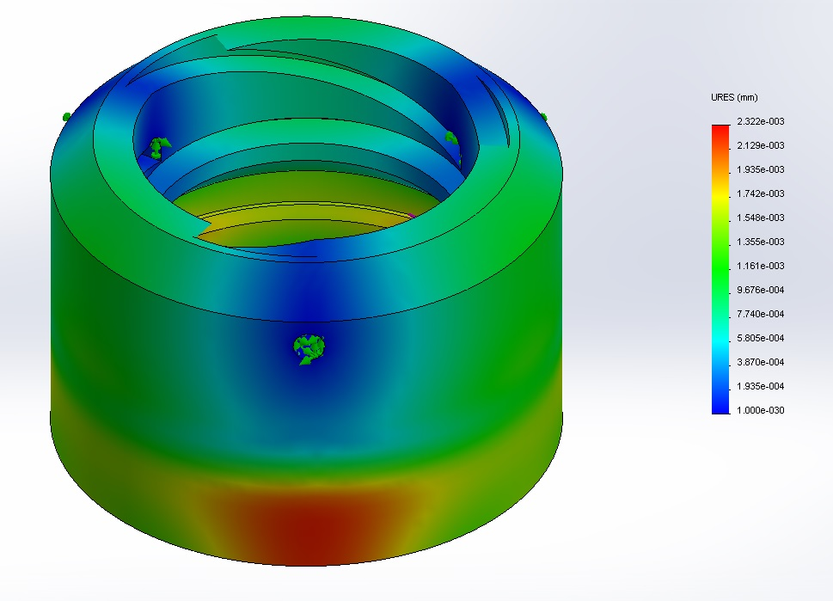
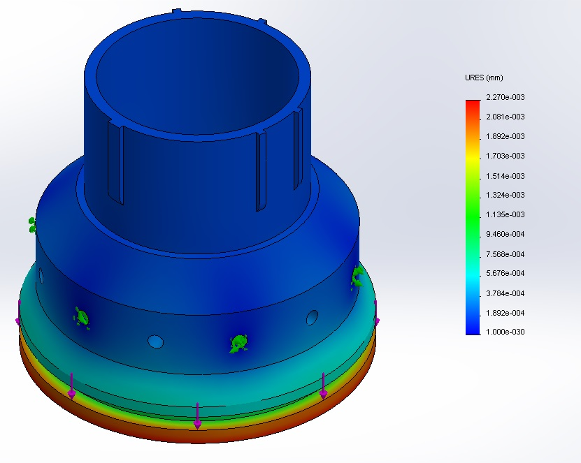
Deflection Analysis at Full Load
Notes:
Green arrows are fixtures.

Slide 12
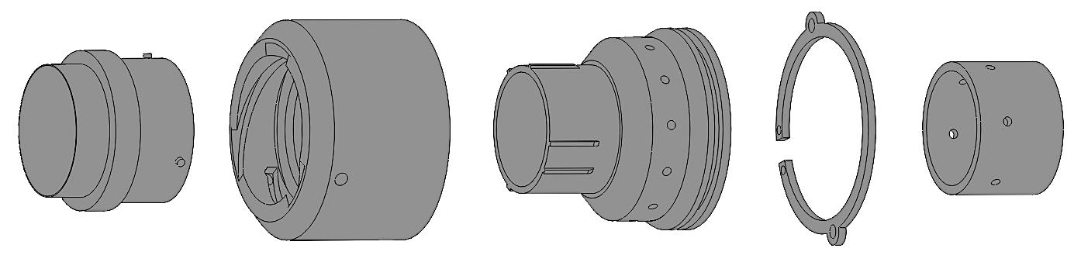
Final Design (Exploded View)
Coupling
Leash Ring
Spring Retention Ring
Male End
Female End

Slide 13

Design Assembly Animation

Slide 14
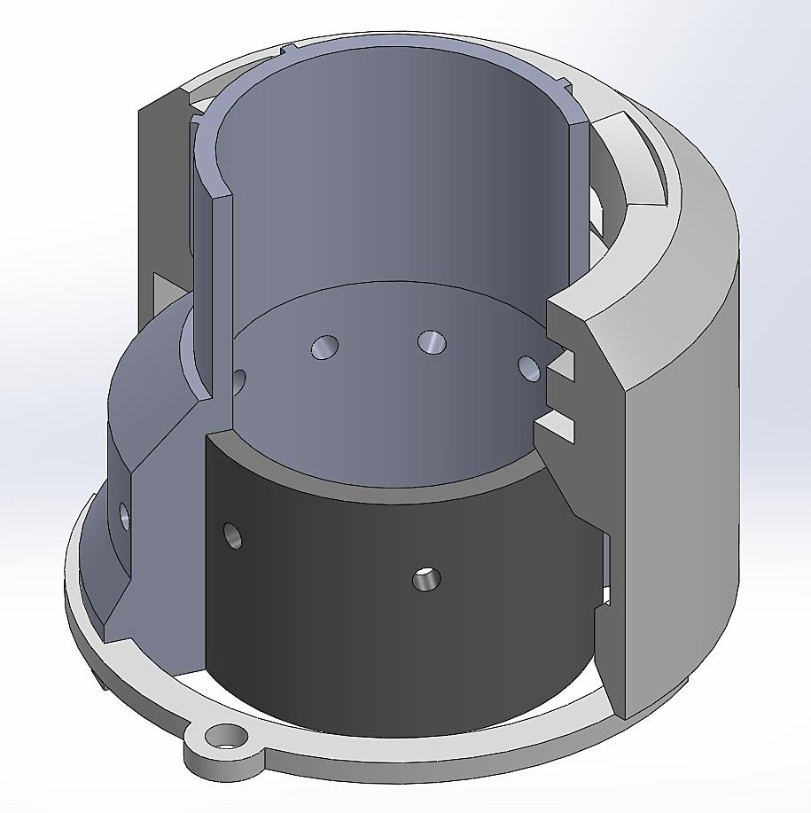
Final Design (Cross-Sectional View)
Coupling
Helical Grove
Female end
Wave Spring Grove
Ball Detent
Retention Track
Spring Retention Ring
Leash Ring

Slide 15
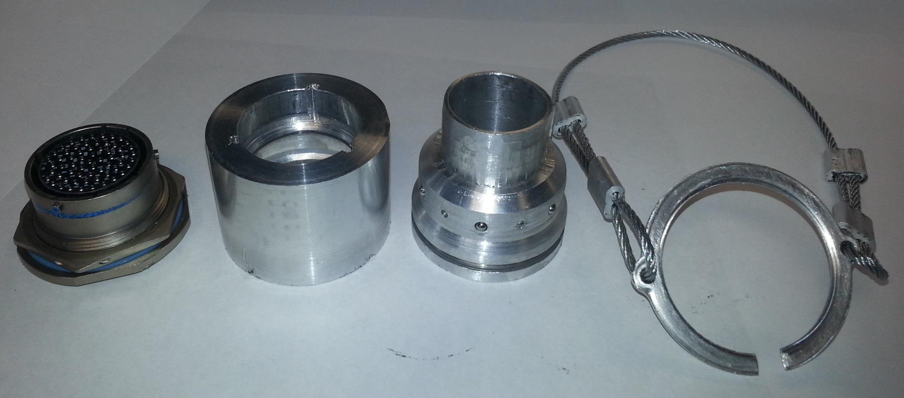
Metal Prototype (Exploded View)

Slide 16
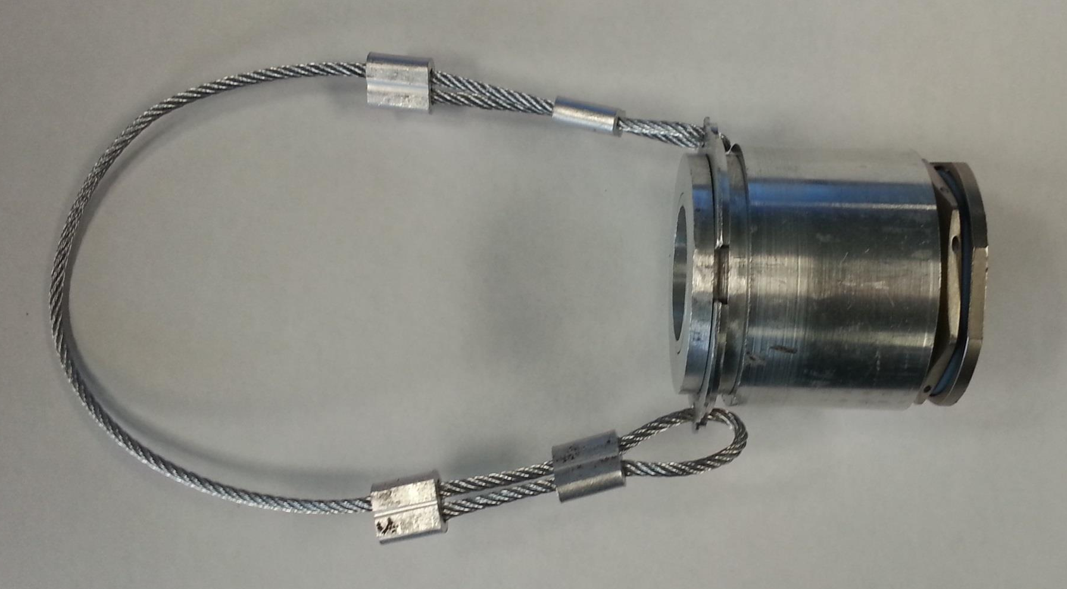
Metal Prototype (Assembled)

Slide 17
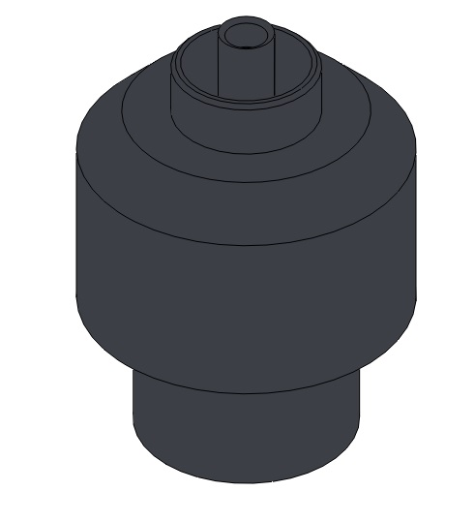
Manufacturing
Created the ball bearing crimp tool
  Allows for the removal of the Spring Retention Ring

Slide 18
Conclusion
Design requirements met
  Does not fail after 50 mate/de-mates
  De-mates with ~27 lbf.
  Male end was not changed
  New design is approximately 10% larger than the original
  Mechanically robust
Merits of new design
  Easy to manufacture
  Inexpensive
  More reliable

Slide 19
Acknowledgments
Mrs. Mary Rogers of Orbital Sciences Corporation
Dr. Srinivas Kosaraju of Northern Arizona University
Professor Perry Wood of Northern Arizona University
Tom Kothrin of Northern Arizona University’s Machine Shop
Zheng Lian Team Member

Slide 20
Questions?

